Slide 1

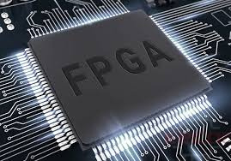
FPGA BASED DIGITAL CIRCUIT APPLICATIONS USING VERILOG
Y.RAJESH- R200012
P.KARTHIK - R200036
K.SATHVIKA- R200527

Slide 2


INTRODUCTION
In this project, we have designed a Digital Clock, Stopwatch, and Scrolling Message Display Device using Verilog on the Nexys A7 FPGA board.
The main aim is to understand how digital systems work and how we can build them using hardware description languages.
We used Xilinx Vivado software to write the code, simulate it, and load it onto the Nexus A7 FPGA board.
This project helped us learn how to design, test, and run real-time digital applications on hardware.
┌───────────────────────┐
│ 12:45:30 PM │ ← Digital Clock
│ STOPWATCH: │
│ 00:23.45 │ ← Stopwatch
│ HELLO FPGA WORLD... │ ← Scrolling Text
└───────────────────────┘

Slide 3


WHAT IS FPGA?
FPGA: Field Programmable Gate Array.
It is a type of programmable chip.
FPGAs contain programmable logic blocks and interconnection circuits.
These can be programmed or reprogrammed to the required functionality after manufacturing.

Slide 4
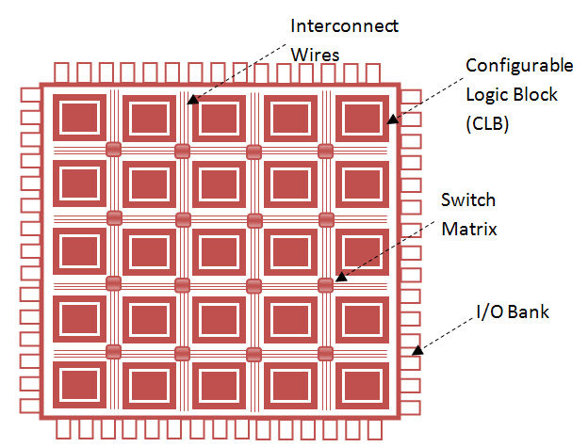
FPGA ARCHITECTURE

Slide 5
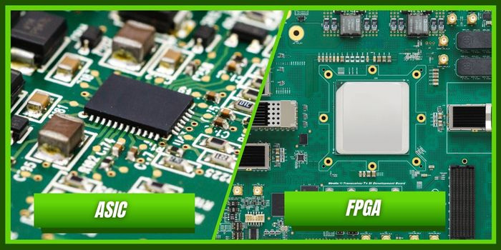
FPGAs VS ASICs
FPGA is like a blank board you can reprogram and use for different tasks, even after buying it.
ASIC is made for one specific job and can't be changed once it's built.
FPGAs are great for testing ideas or doing small projects.
ASICs are better for mass production where the same task is done again and again.
FPGAs are flexible and faster to develop, but a bit slower in performance.

Slide 6
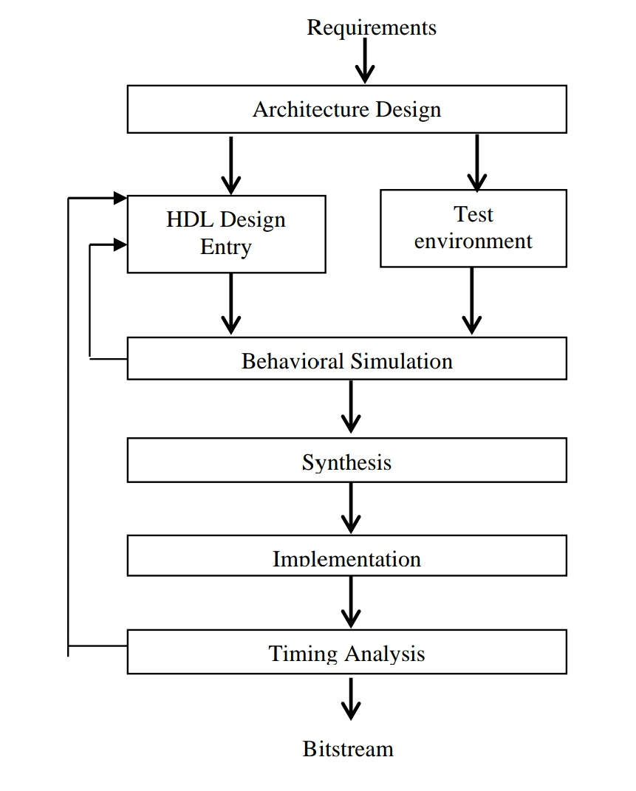
FPGA DESIGN FLOW

Slide 7




Real-Time Systems on Nexys A7
01.
DIGITAL CLOCK
02.
STOP WATCH
This project aims to design a some real time applications using Verilog HDL.
The designs will be implemented and verified on the Nexys A7 FPGA board using the Xilinx Vivado tool.
SCROLLING MESSAGE DEVICE
03.

Slide 8
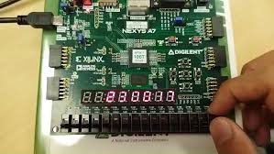
DIGITAL CLOCK-VerilogImplementation
Objective :
Display real-time hours, minutes, seconds using 7-segment
Modules used:
seven segment display code
Frequency Division
Display code
Counter
24 hours logic code
delay module

Slide 9
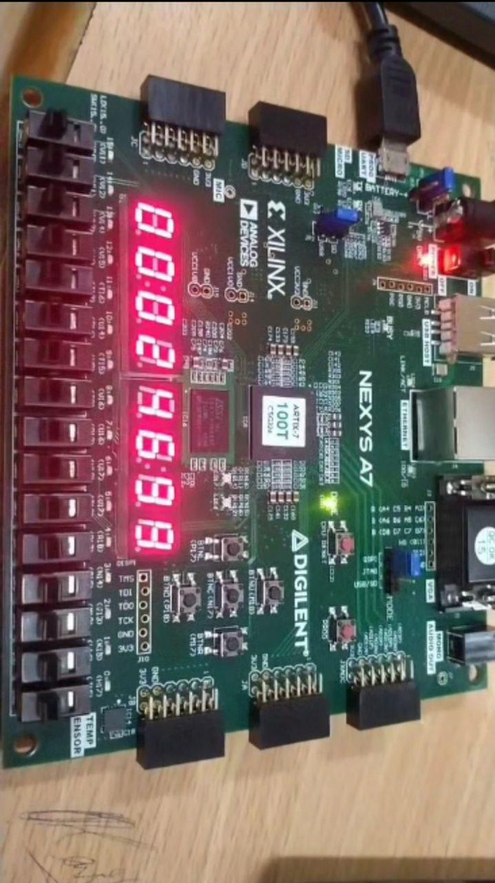
STOP WATCH-Verilog Implementation
Objective :
To display real-time stopwatch with minutes, seconds,reset and stop using 7-segment
Modules used:
seven segment display code
Frequency Division
Display code
Counter
24 hours logic code
delay module

Slide 10
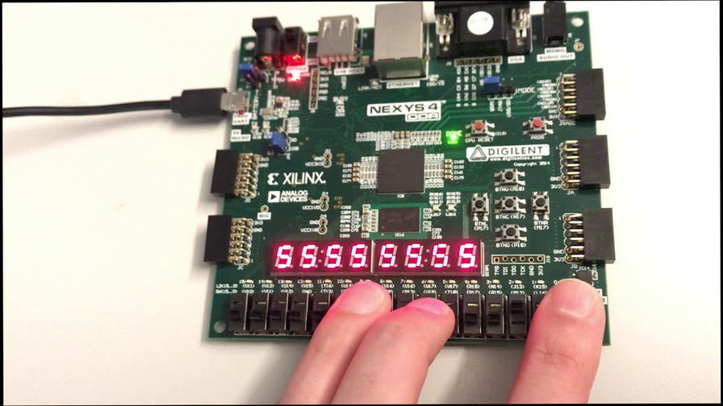
SCROLLING MESSAGE DEVICE-Verilog Implementation
Objective :
To display scrolling text on a 7-segment display using Verilog and implement it on an FPGA board for demonstrating digital design and real-time message control.
Modules used:
seven segment display code
Frequency Division
Anode brightness module
Counter
Initialisation of letters module
delay module

Slide 11
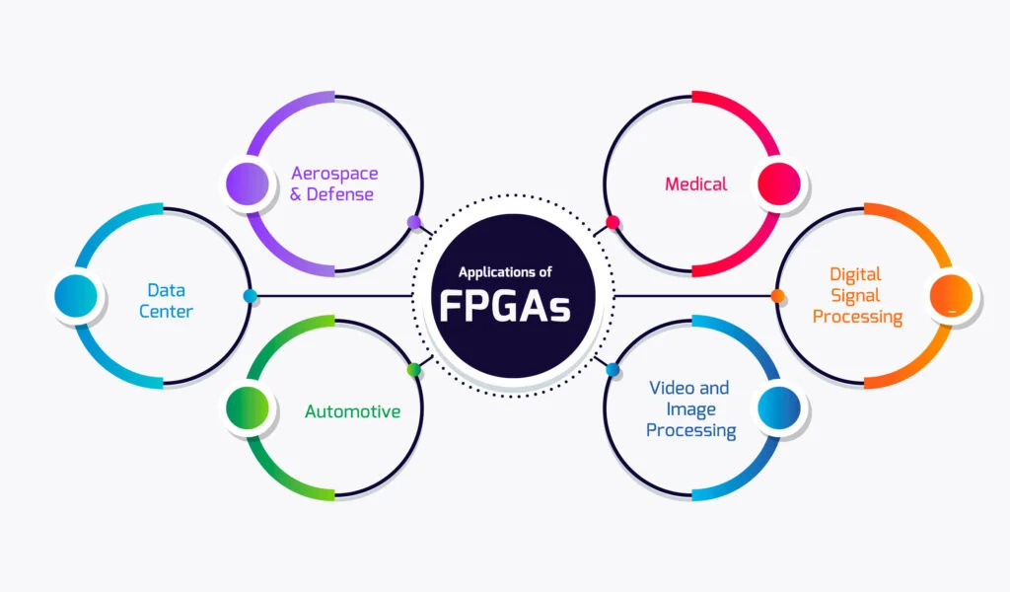
FPGA APPLICATIONS

Slide 12
CONCLUSION
Key Learnings
Gained hands-on experience with Verilog HDL and FPGA-based design.
Learned how to implement and test real-time digital systems on hardware.
Challenges
Managing accurate timing and synchronization on the FPGA.
Debugging hardware issues and ensuring proper display outputs.
Future Scope
Add alarm and countdown timer features to the clock and stopwatch.
Expand scrolling display to support custom fonts or longer messages using external displays.

Slide 13
REFERENCES
Xilinx Inc., Vivado Design Suite User Guide: Getting Started (UG910), 2023.
https://www.xilinx.com/support/documentation-navigation/design-hubs/
dh0002-vivado-design-hub.html
NEXYS 4 A7 board Manual :
https://digilent.com/reference/_media/nexys4-ddr:nexys4ddr_rm.pdf

Slide 14

Thank you very much!

